Slide 1
Nuclear for climate
Engaging in Marrakech
Anouk ter Brugge

Slide 2

INDEX
N4C
COP21
COP22
Share

Slide 3
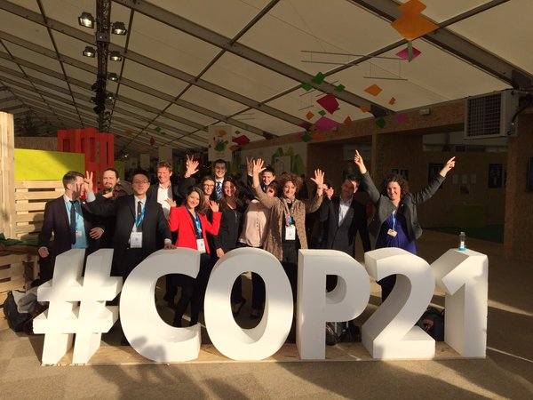
N4C
An initiative from nuclear associations for COP21

Slide 4
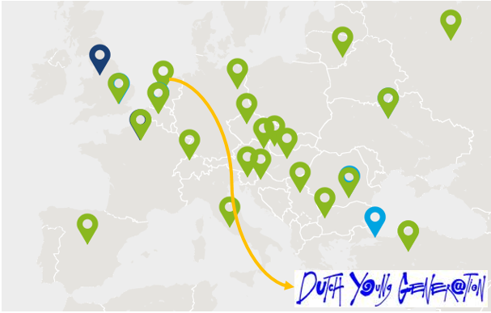
N4C
148 nuclear associations worldwide are connected

Slide 5
COP21
Countries commit to a long-term goal of keeping the increase in global average temperature below 2°C (stretch goal at 1,5°C)
Governments submitted national climate action plans (INDCs):
  not yet enough to keep global warming below 2°C (est. 2,7°C):
  Agreement to gather every 5 years to set more ambitious targets (incl reporting, transparency and accountability systems)
195 countries adopted the global climate deal

Slide 6

COP22
Update on COP21 goals

Slide 7
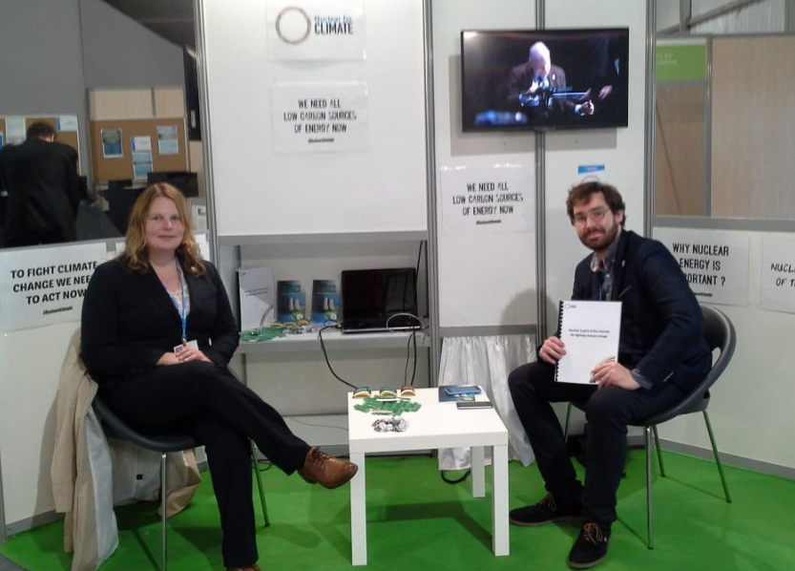
share
Booth in the UN Blue zone

Slide 8
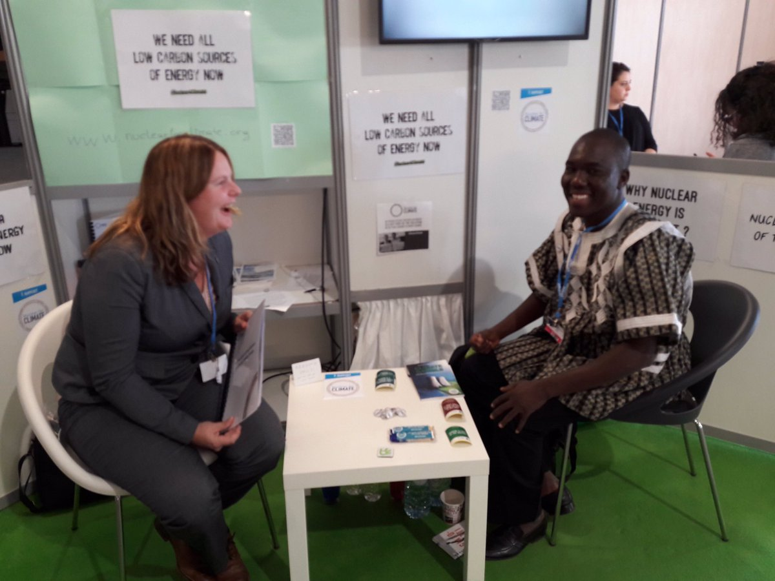
share
Audiences in conferences

Slide 9
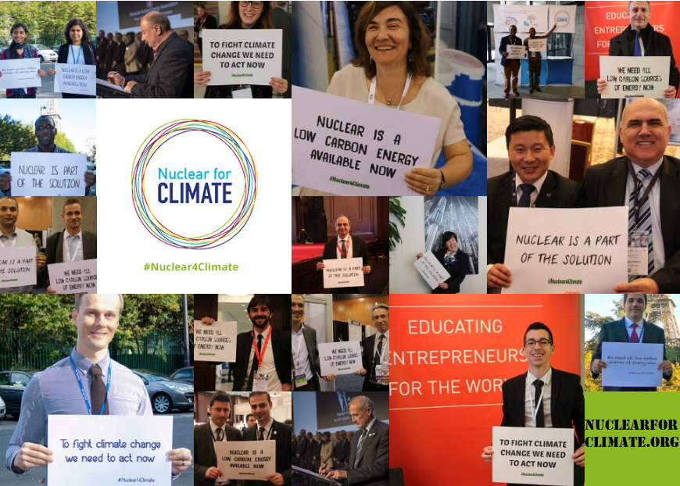
Thank you for your attention

Slide 11
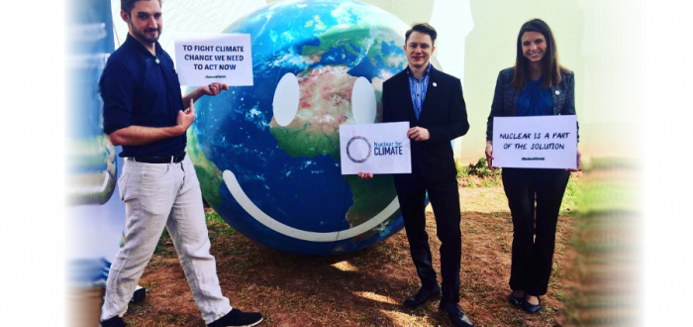

Slide 12
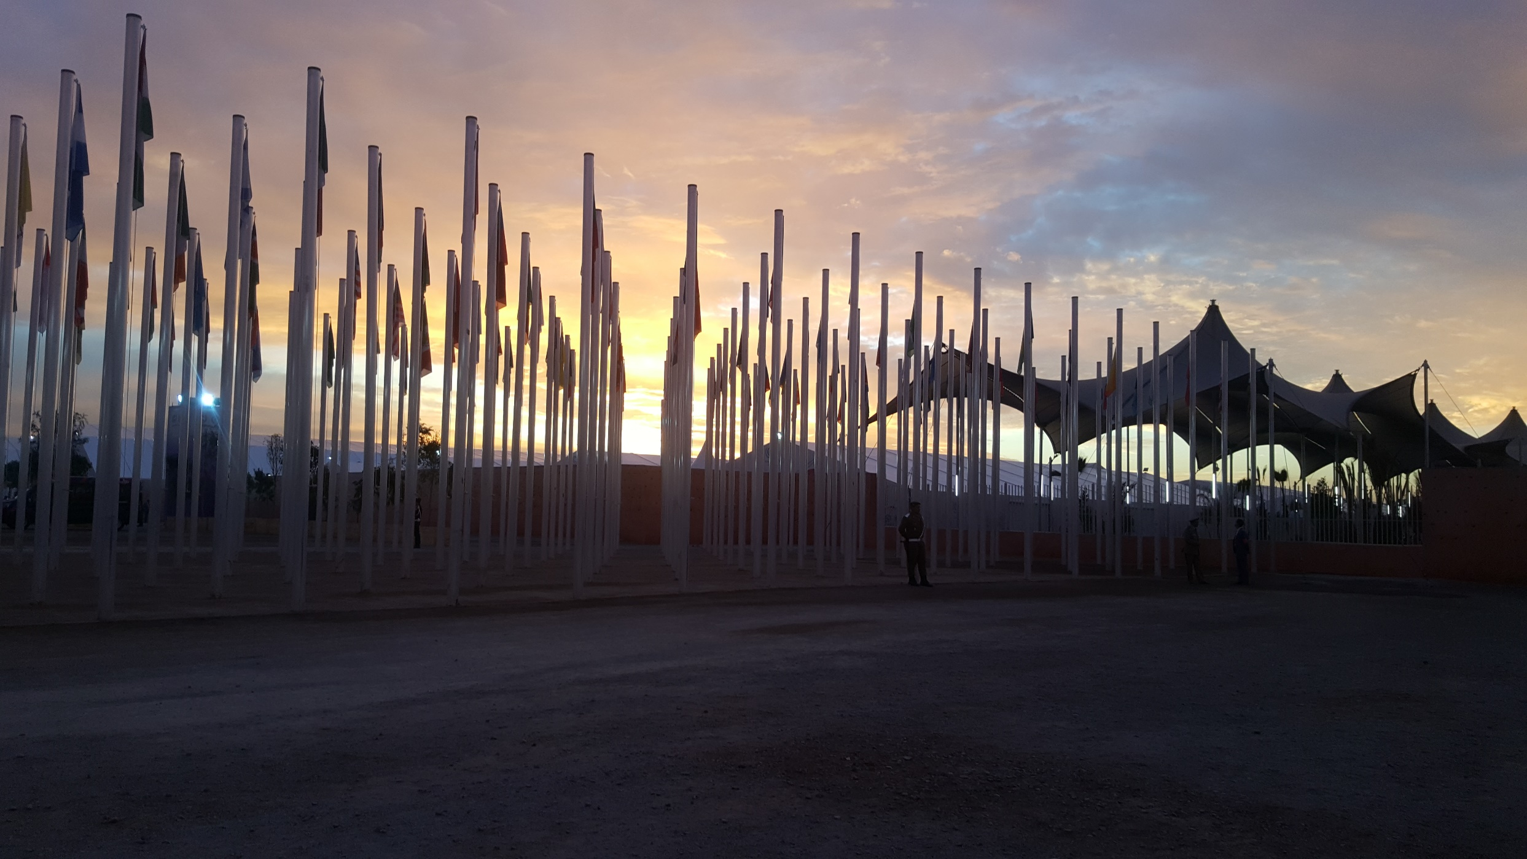

Slide 13
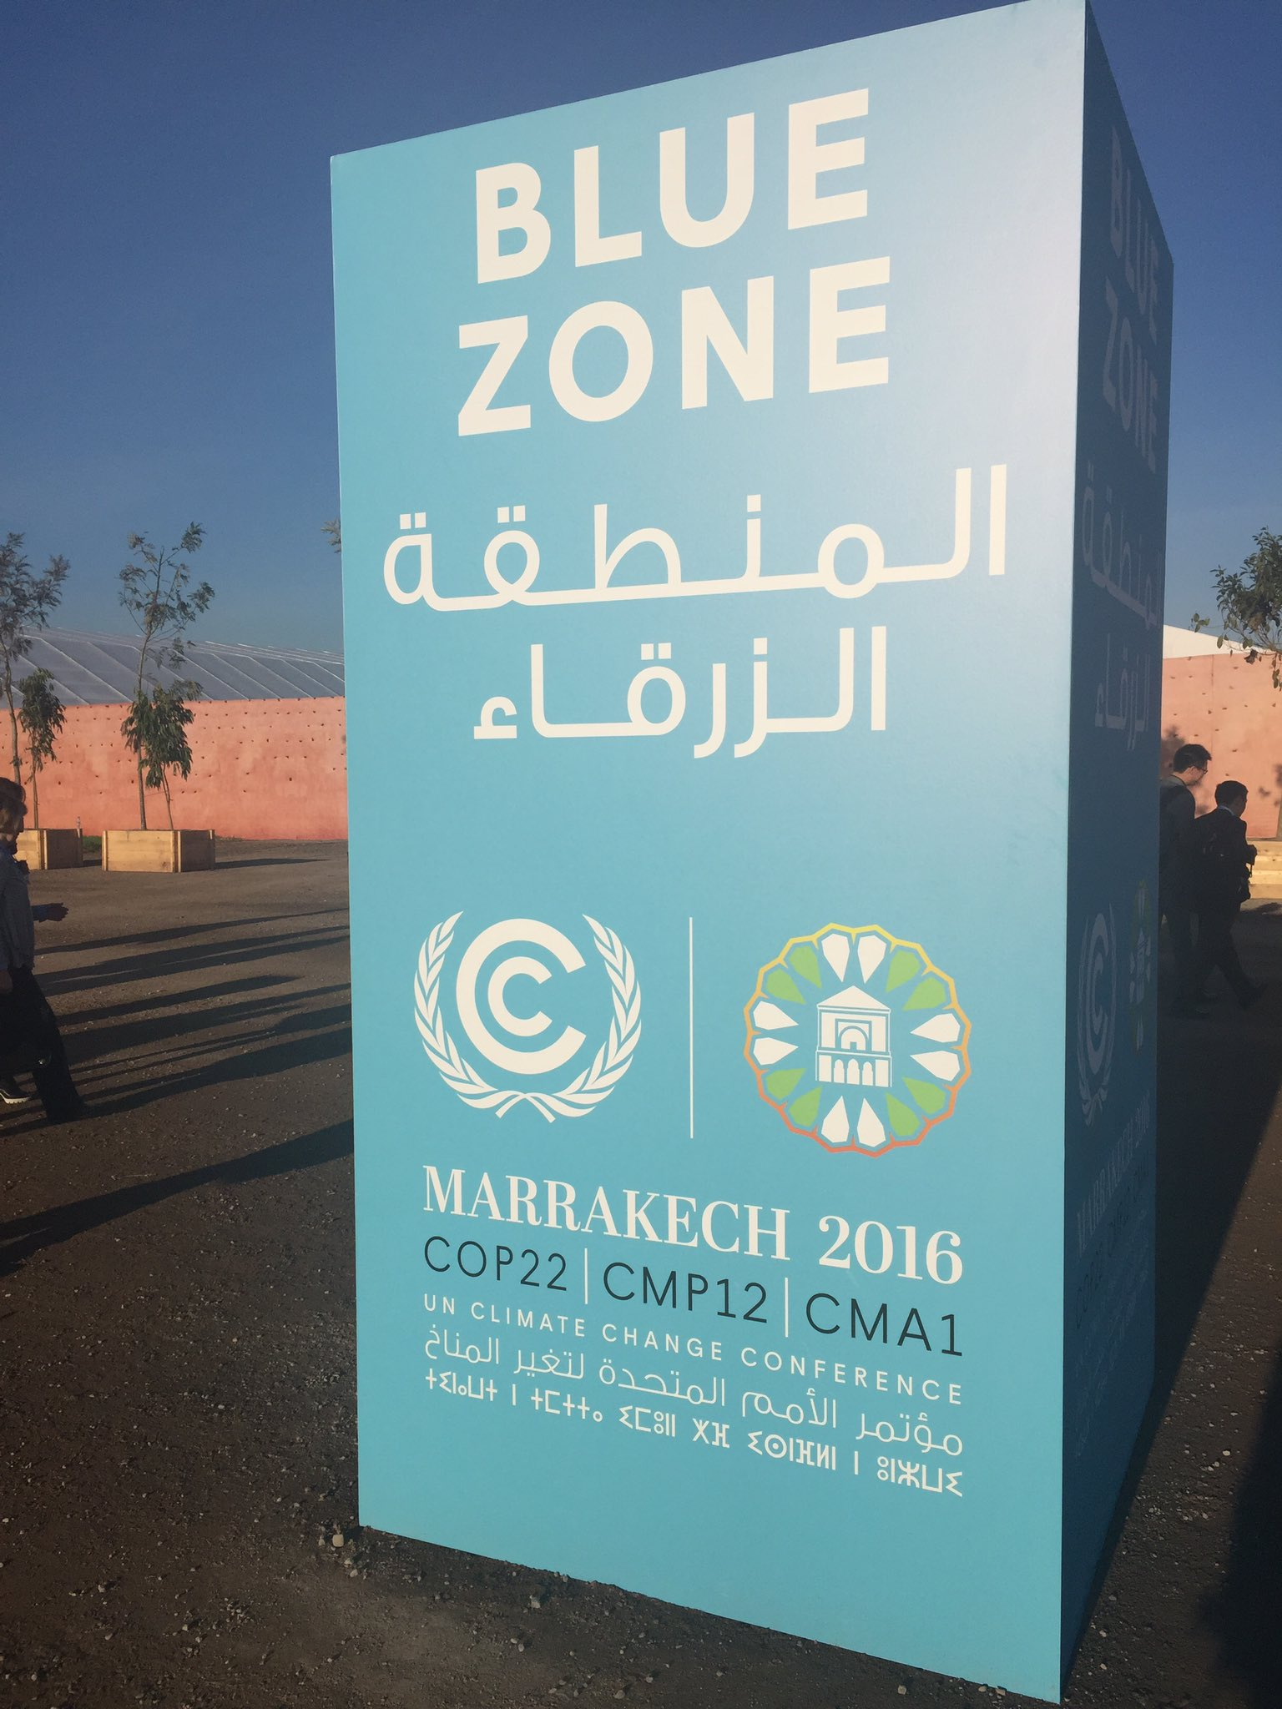

Slide 14
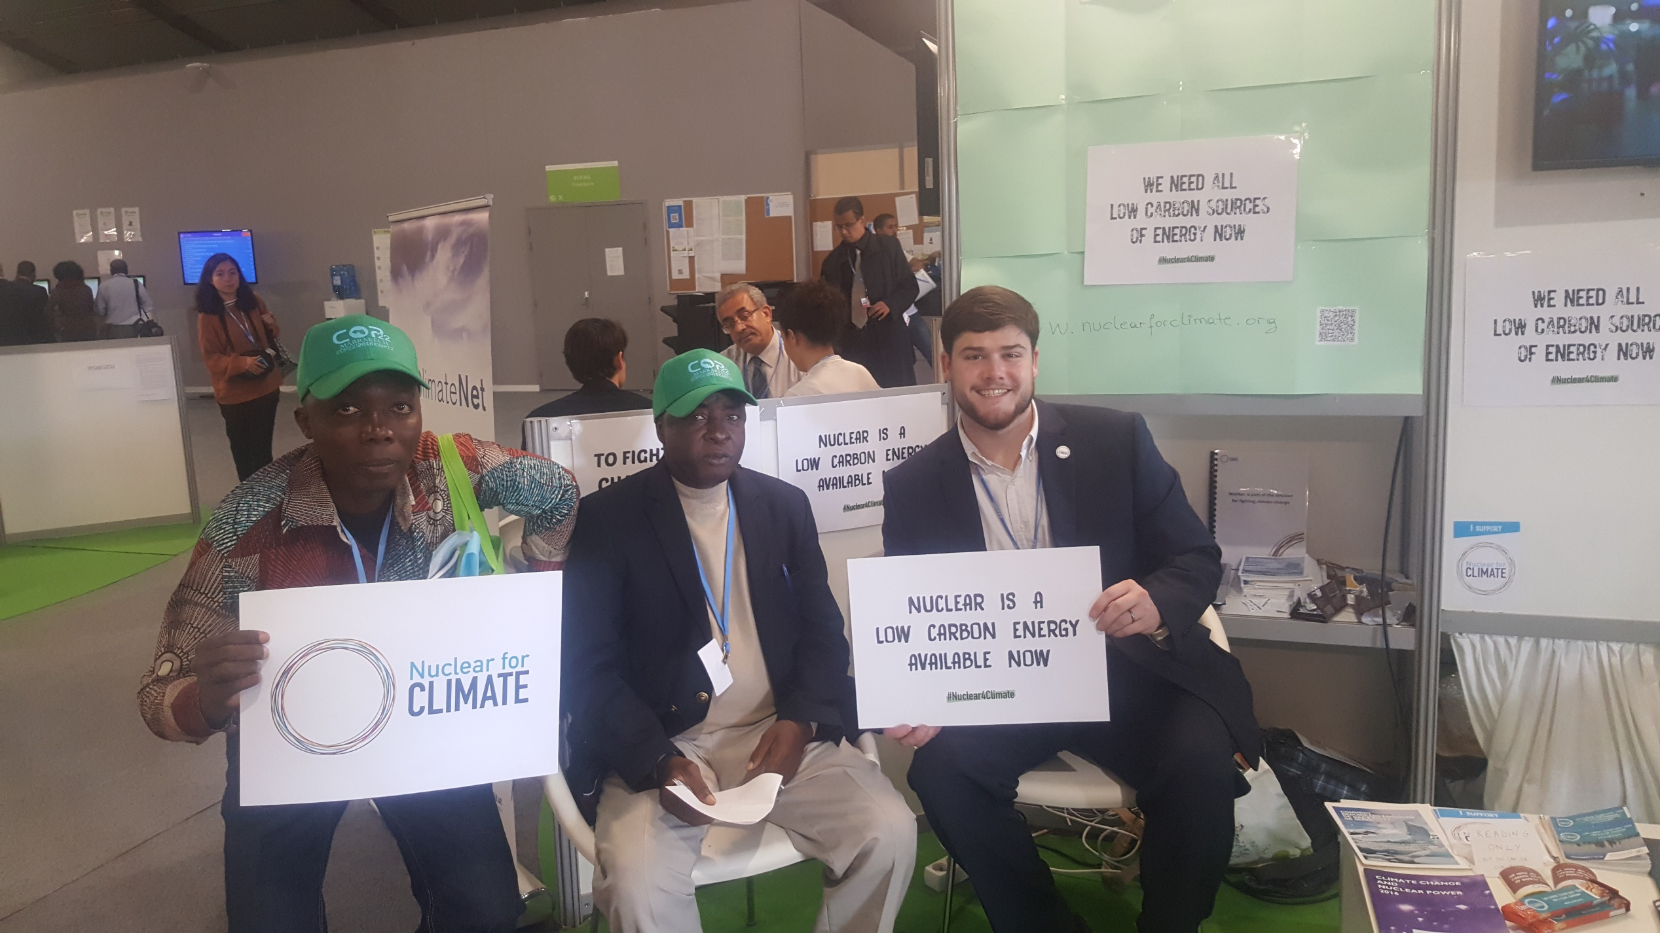

Slide 15
