Slide 1
The Nuclear Elephant
3rd March 2017
Amsterdam
“Mythbusting Nuclear” -roast with
Rauli Partanen & Janne M. Korhonen

Slide 2
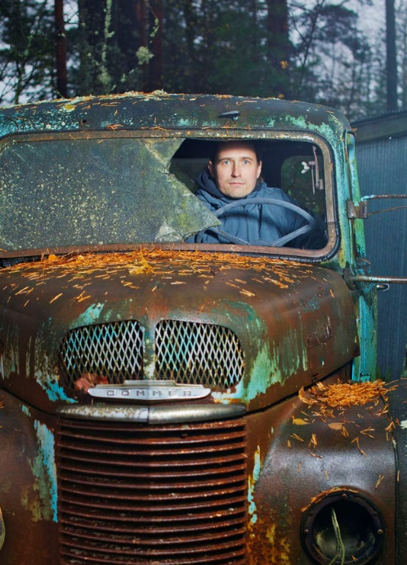
Who we are
Rauli Partanen
Father of three,
independent author, activist
Janne M. Korhonen
M.Sc.(Tech)
Doctoral student, AbD
Independent researcher

Slide 3
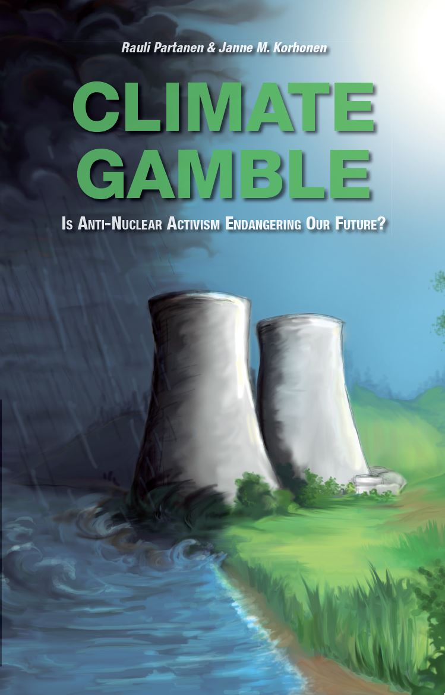
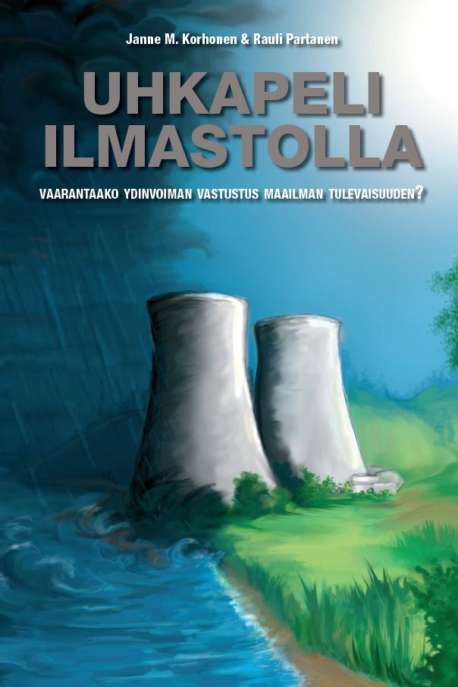
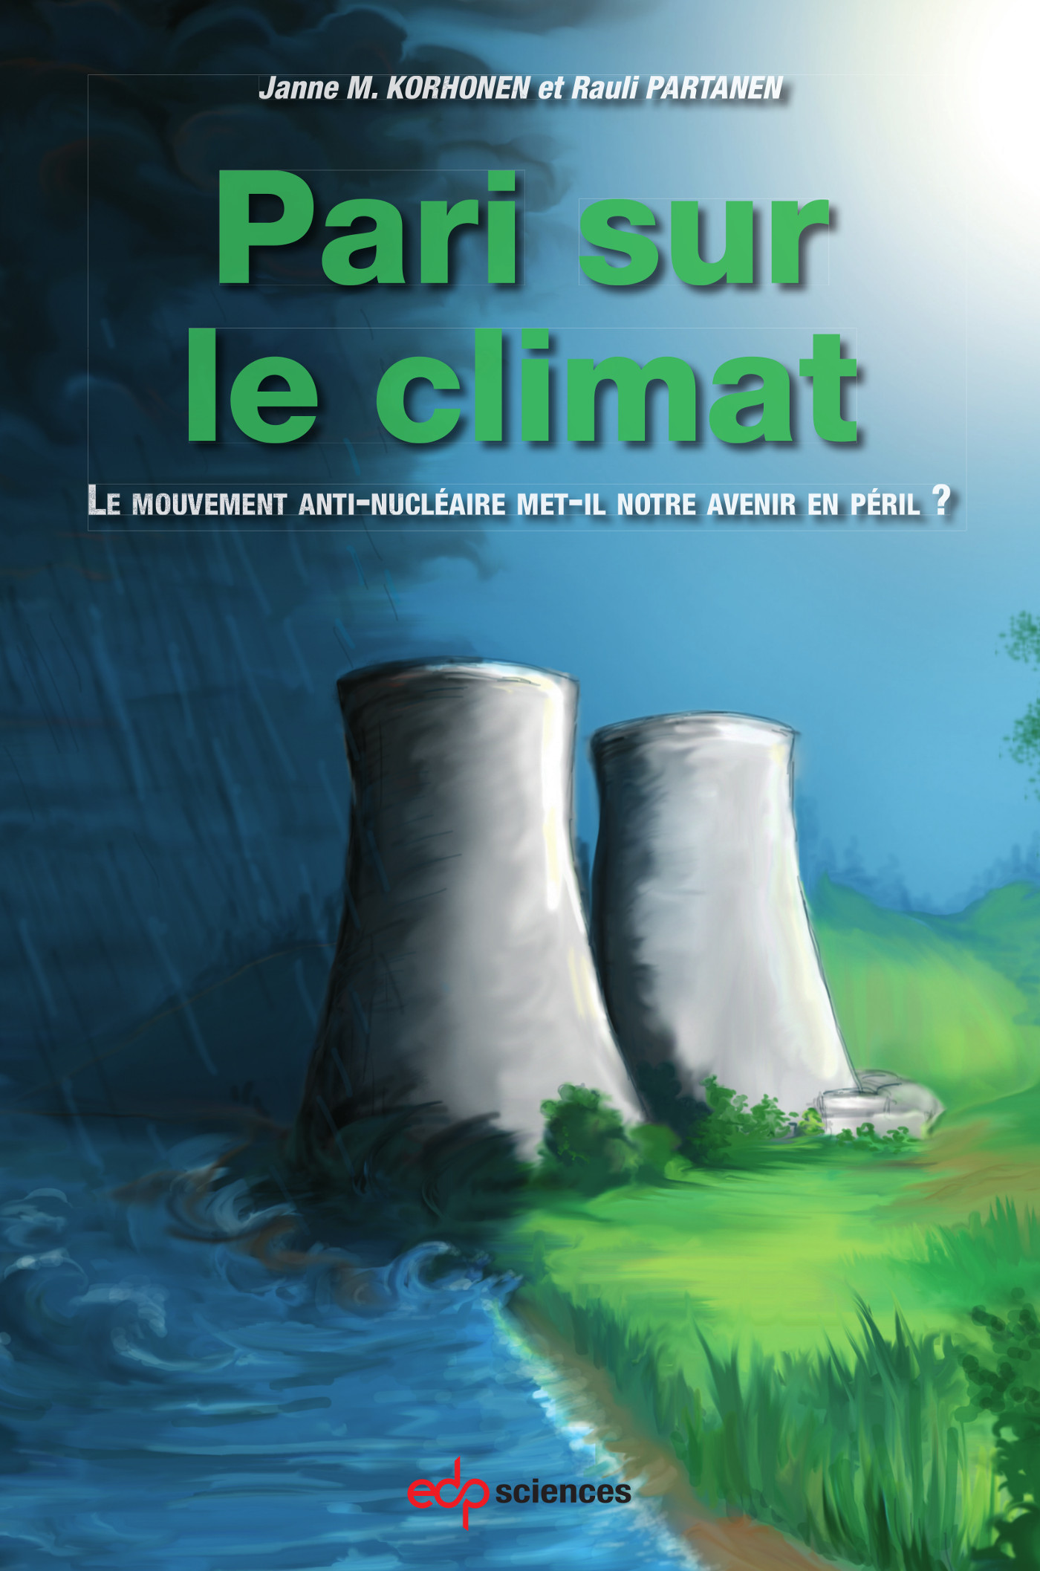
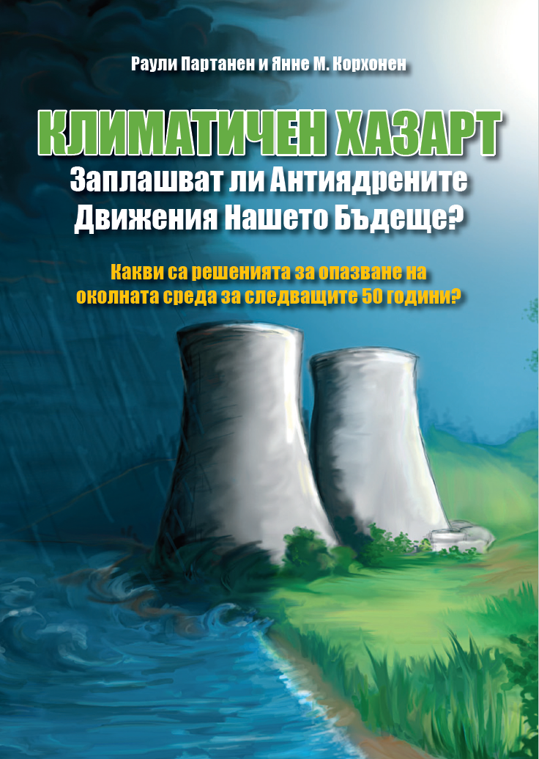
Why we are here?
We wrote a book called “Climate Gamble – Is Anti-Nuclear Activism Endangering Our Future?”

Slide 4
So is it? Is Anti-Nuclear Activism Endangering Our Future?

Slide 5
We say that Nuclear Energy is the most misunderstood and misrepresented energy source there is. And here is why.

Slide 6
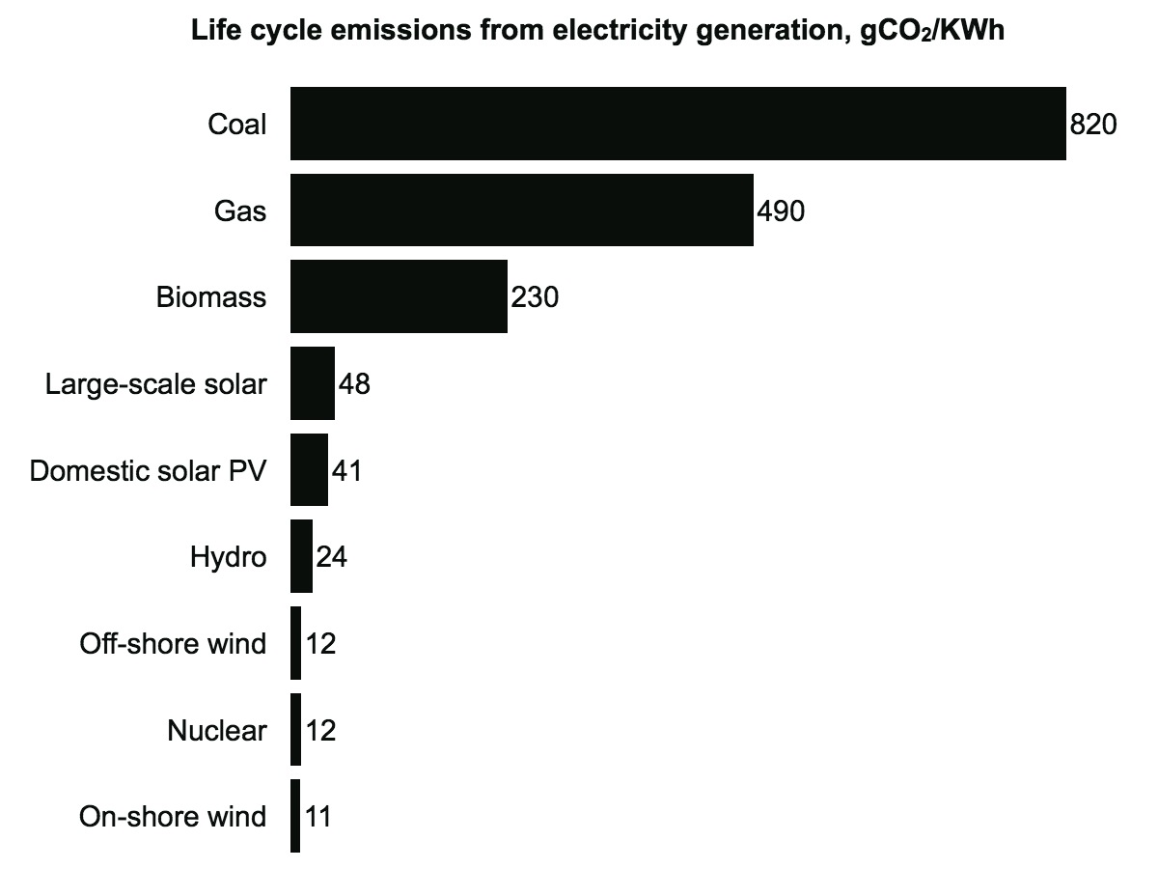
Show of hands: is nuclear power low-carbon?
Yes. Nuclear is low-carbon.
Data: IPCC 2014

Slide 7
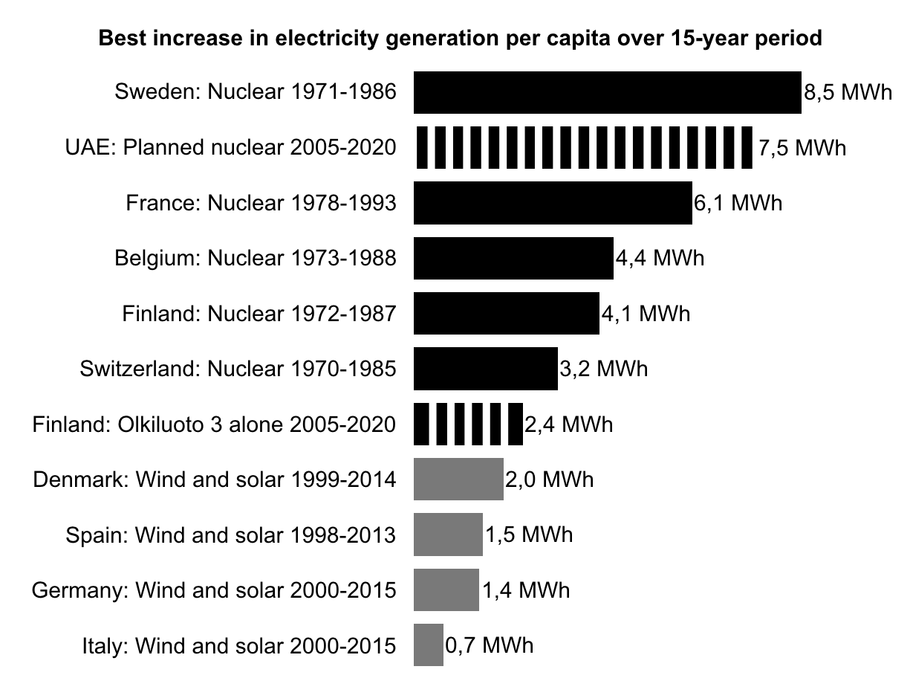
Show of hands: is nuclear power fast to build?
Yes. Nuclear is low-carbon.
Yes. Nuclear is the fastest.
Data: BP 2016

Slide 8
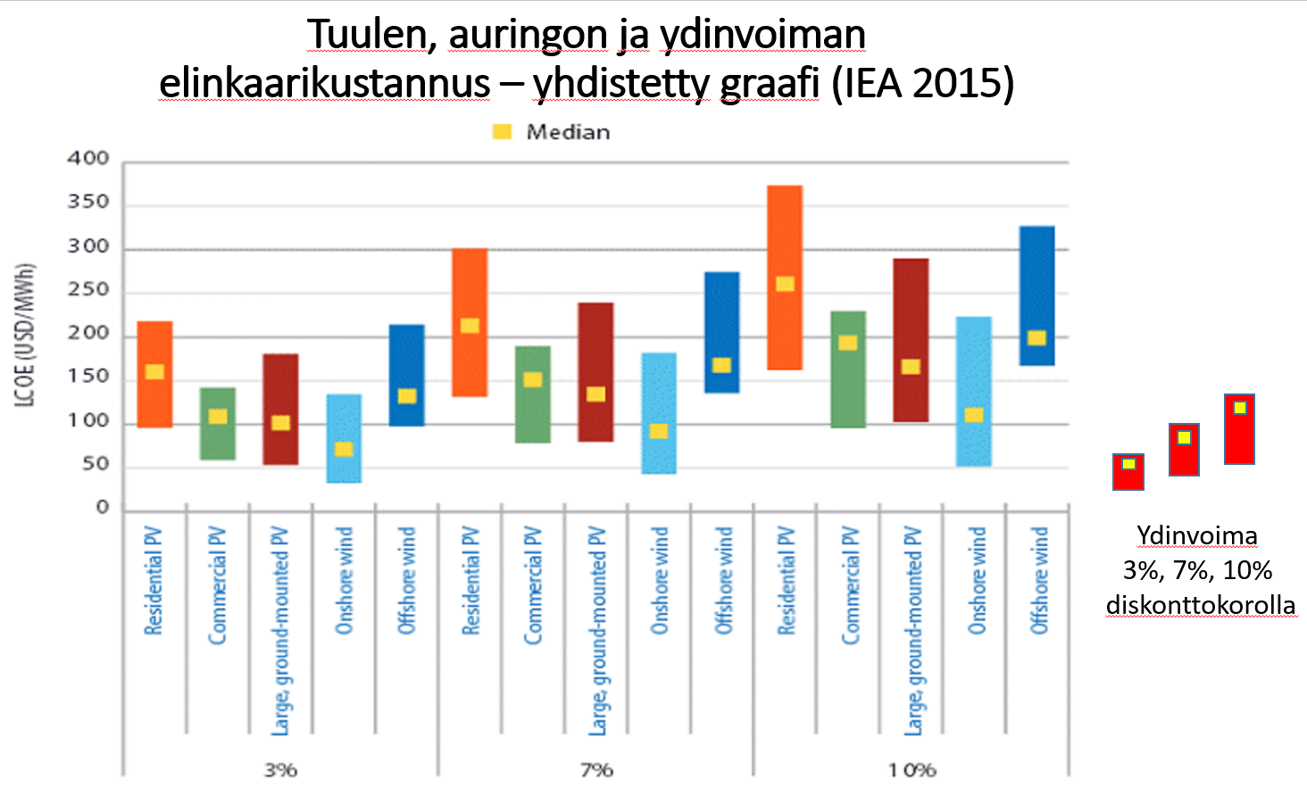
Show of hands: is nuclear power expensive?
Yes. Nuclear is low-carbon.
Yes. Nuclear is the fastest.
Nuclear power is cheaper than other clean energy.
Life-cycle Cost of Electricity (LCOE) for wind, solar and nuclear.
Combined graph from IEA 2015
Nuclear at 3%, 7%, 10% discount rate
Data: IEA 2015

Slide 9
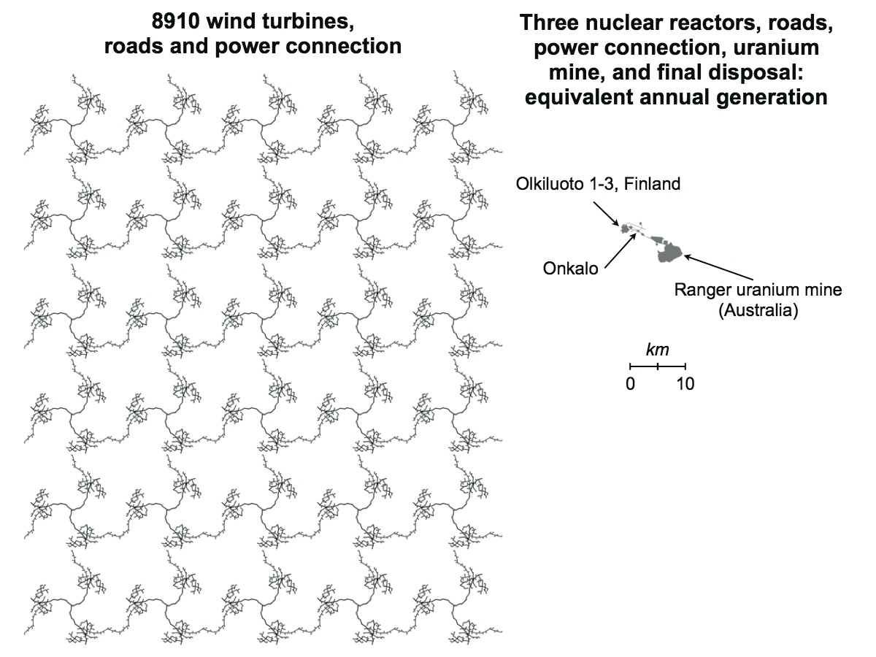
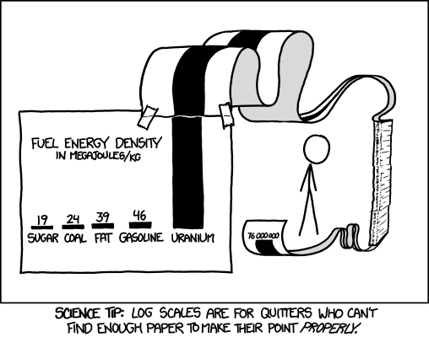
Show of hands: is nuclear power ecological?
Yes. Nuclear is low-carbon.
Yes. Nuclear is the fastest.
Nuclear power is cheaper than other clean energy.
Nuclear has a small footprint.
Data: environmental assessments, Google maps The Internet (for the meme on left).

Slide 10
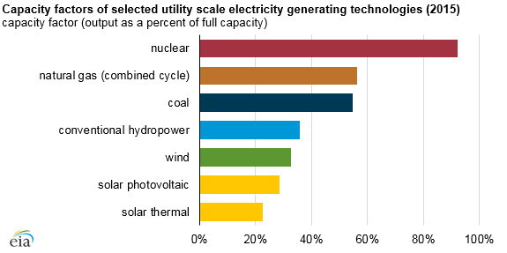
Show of hands: is nuclear power dependable?
Yes. Nuclear is low-carbon.
Yes. Nuclear is the fastest.
Nuclear power is cheaper than other clean energy.
Nuclear has a small footprint.
Nuclear power is the most dependable there is.
Data: EIA

Slide 11
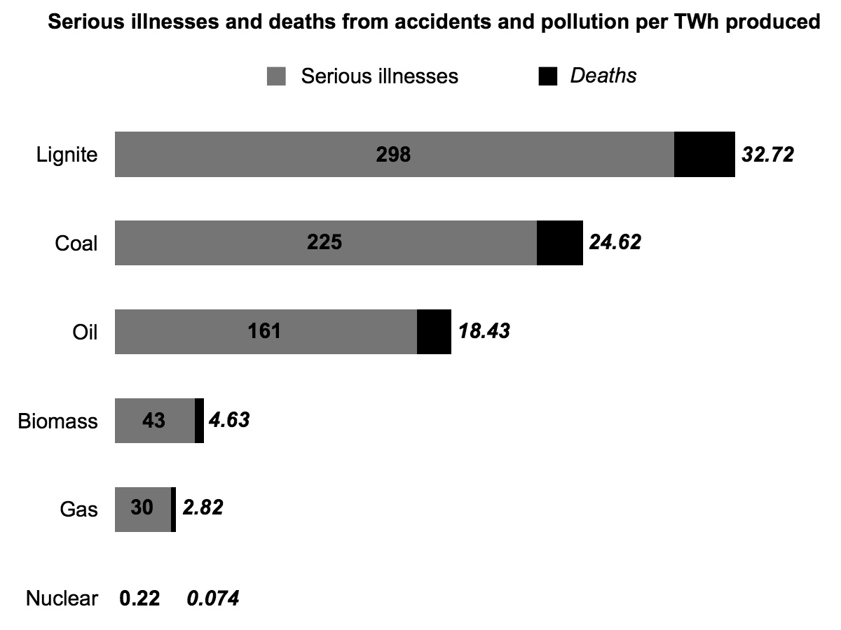
Show of hands: is nuclear power risky?
Yes. Nuclear is low-carbon.
Yes. Nuclear is the fastest.
Nuclear power is cheaper than other clean energy.
Nuclear has a small footprint.
Nuclear power is the most dependable there is.
Nuclear power is safest.
Data: The Lancet

Slide 12
Show of hands: is nuclear waste a big problem?
Yes. Nuclear is low-carbon.
Yes. Nuclear is the fastest.
Nuclear power is cheaper than other clean energy.
Nuclear has a small footprint.
Nuclear power is the most dependable there is.
Nuclear power is safest.
Nope. Nuclear power still safest.
Includes long term waste storage, accidents, radiation, you name it.
Data: The Lancet

Slide 13
Show of hands: Do we need to do everything we can to stop climate change?
Yes. Nuclear is low-carbon.
Yes. Nuclear is the fastest.
Nuclear power is cheaper than other clean energy.
Nuclear has a small footprint.
Nuclear power is the most dependable there is.
Nuclear power is safest.
Nope. Nuclear power still safest.
Yes: we need a lot of everything!
Data: IPCC 2011

Slide 14
Show of hands: Do we need to do everything we can to stop climate change?
Yes. Nuclear is low-carbon.
Yes. Nuclear is the fastest.
Nuclear power is cheaper than other clean energy.
Nuclear has a small footprint.
Nuclear power is the most dependable there is.
Nuclear power is safest.
Nope. Nuclear power still safest.
Yes: we need a lot of everything!
Limiting tools limits progress. Tech-neutral scenarios ~10 times faster than RE only.
Data: Loftus et al. 2015

Slide 15
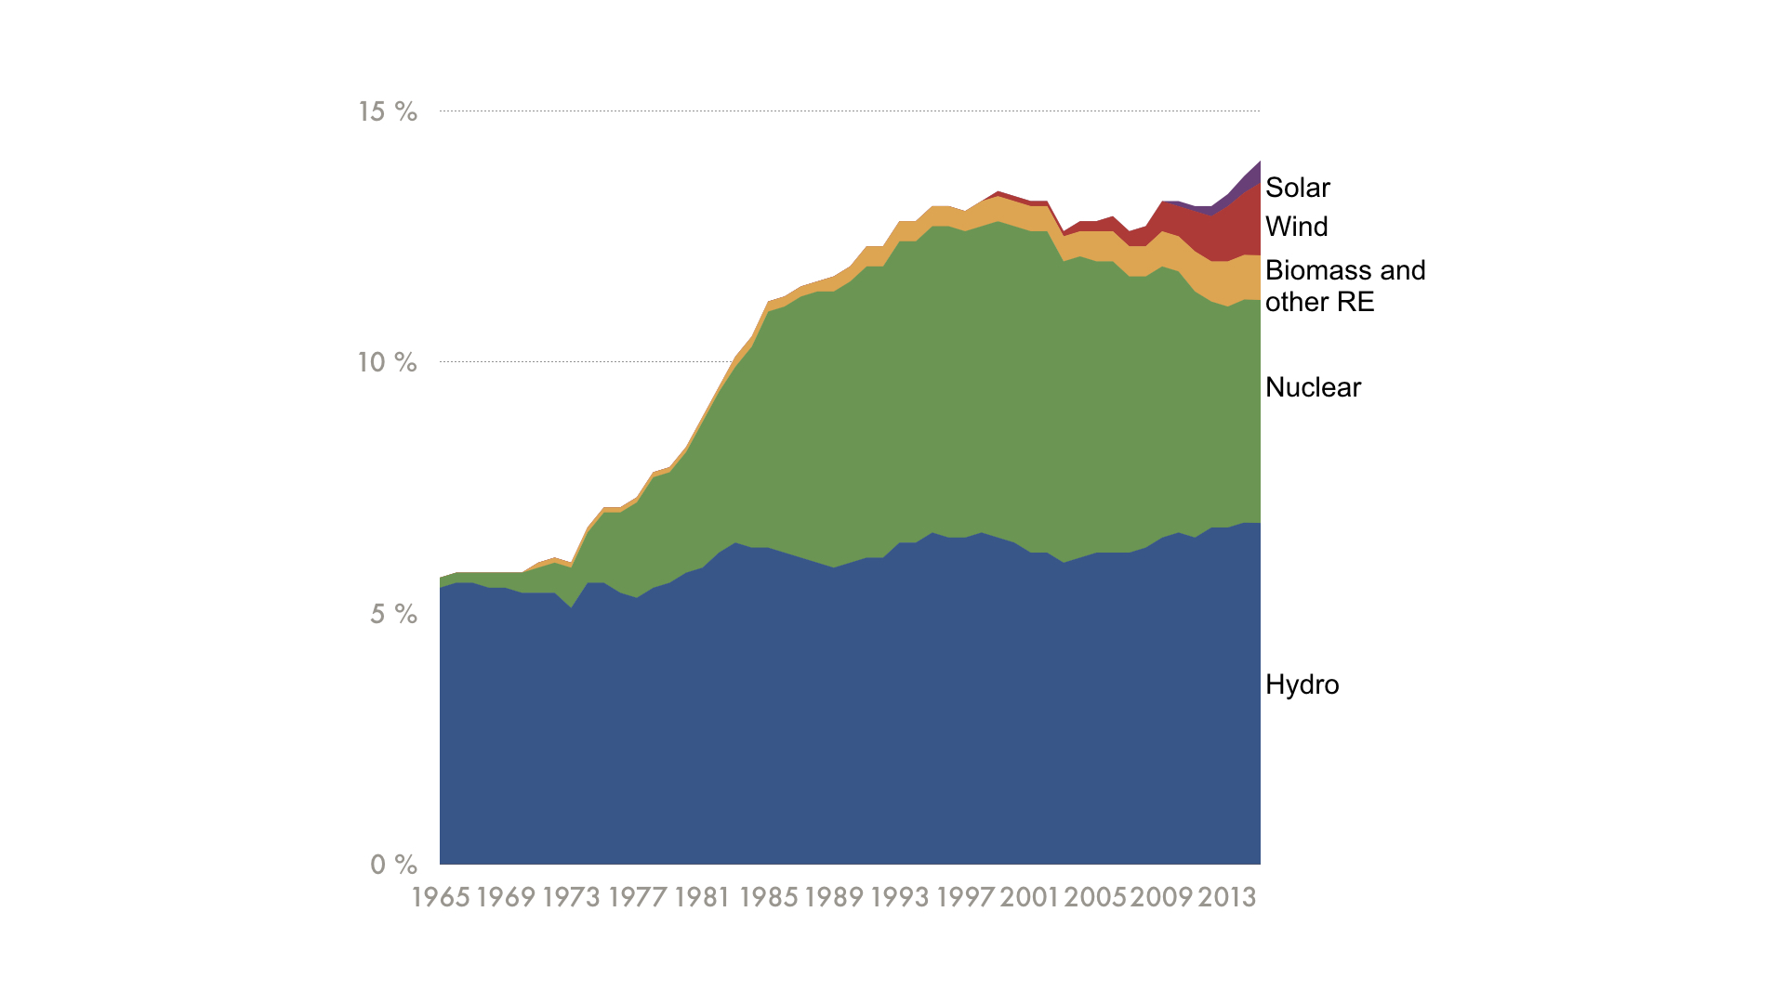
Actually, the only time when the share of low carbon energy has gone up significantly…
Was in the 1970s to 1990s when we built nuclear
Data: BP 2016

Slide 16
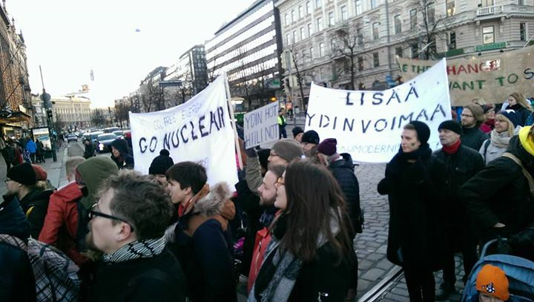
Finally: Who thinks Nuclear Industry has done a poor job of communicating all of the facts listed?
We think it has.
But a growing group of environmental activists are supporting it, because the evidence says we will do much better with nuclear than without.
Picture: Climate March 2015 in Helsinki

